Slide 1





Survey
Expository Writing | Air University Kamra
SHORT VIDEOS AND
ACADEMIC PERFORMANCE
  Wasif Ali (245187)
  Anisa Khan (245215)
  Faiqa Umer (245161)

Slide 2




INTRODUCTION
Why This Topic?
Rise of short videos (TikTok, Reels, Shorts) in student life
Balance between entertainment and study is a challenge
We aimed to explore this impact through a student survey
Short Videos 🎬 : A 60-Second Distraction or a Learning Tool?
1/11

Slide 3



SURVEY OBJECTIVES
S
H
O
R
T
V
I
D
E
O
S
Main Objective:
Identify student usage patterns of short video platforms.
Understand how these videos affect study habits and focus.
Explore whether students find any educational value in such content.
Examine emotional impacts like guilt and fatigue.
Suggest strategies to balance video use with academics.
2/11

Slide 4





METHODOLOGY
  How We Conducted the Survey
    Shared Google Form with university students.
    Total responses: 37 students.
    Questions focused on screen time, purpose, impact, and guilt.
3/11

Slide 5

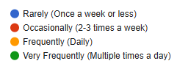

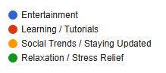

KEY FINDINGS
Usage Patterns :
70.3% of students watch short videos daily.
Most spend 1–2 hours per day, some more than 3.
Main purpose: Entertainment (54.1%), followed by
Few watch videos to learn new things.
Usage is frequent even during study breaks.
Relaxation.
4/11

Slide 6



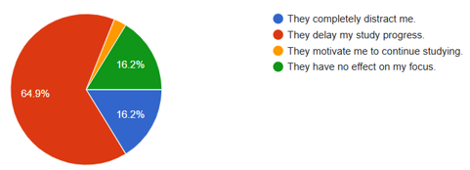
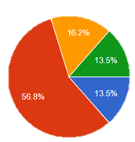

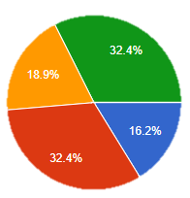

Findings – Academic Impact
How It Affects Studies :
64.9% said videos delay their study progress.
57% said videos sometimes replace study time.
56.8% felt their academic performance is negatively affected.
Majority felt mentally drained after long scrolling sessions.
Guilt reported by many students after wasting study time.
5/11

Slide 7



DISCUSSION – POSITIVE SIDE
Are There Any Benefits?
30% reported educational or stress-relieving benefits.
Some use videos for revision or learning tips.
Motivational and educational content exists—when used intentionally.
Helps students discover quick tricks, summaries, and concept breakdowns.
Can improve mental state with inspiring content.
6/11

Slide 8




DISCUSSION – NEGATIVE SIDE
Most students mainly watch videos just for fun.
Watching too much leads to wasting time and delaying studies.
The bad effects happen more often than any good ones.
Many students lose focus while studying because of constant scrolling.
It's easy to forget study plans when you keep watching videos.
7/11

Slide 9

ROLE OF PERSONAL DISIPLINE
Students who manage their time well do better in studies.
Being self-controlled helps you avoid wasting time on videos.
If you watch short videos with a purpose (like learning), they can help.
But watching too much just for fun can make you lose time and focus.
Everyone is different—your habits decide how videos affect you.
Discipline
Distraction
8/11

Slide 10

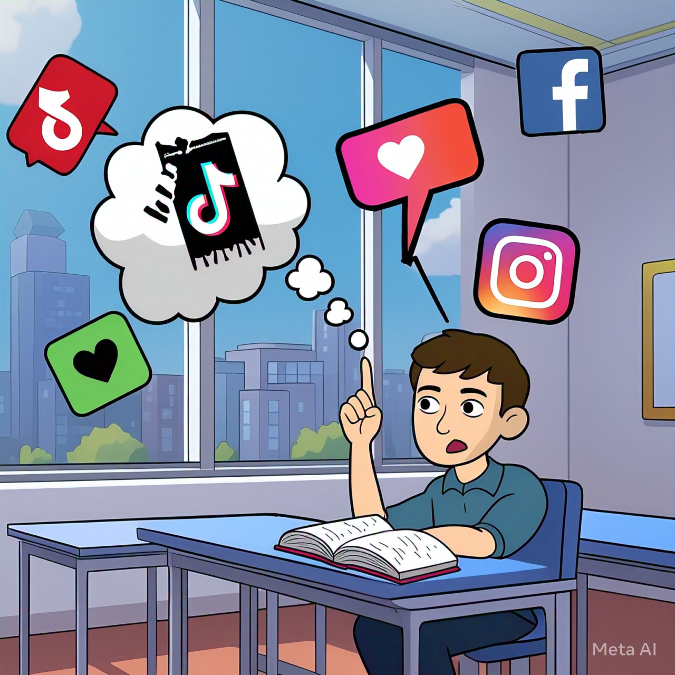
CONCLUSION
Short videos are not entirely bad.
Their impact depends on how they’re used.
Majority use them for fun, which causes distractions.
Without limits, these platforms can harm academic focus.
With balance, they can be useful in small amounts.
9/11

Slide 11





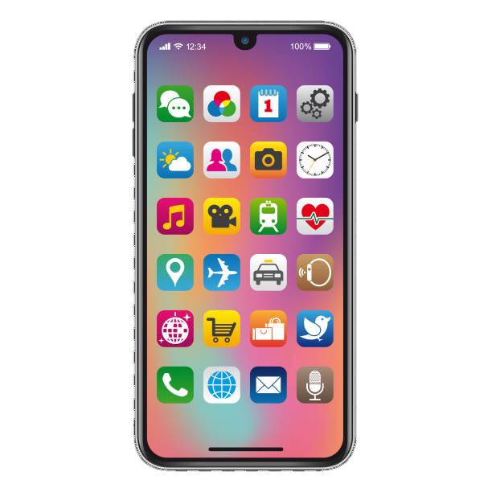










RECOMMENDATIONS
Set daily screen time limits using app timers.
Follow educational content creators, not just entertainment.
Use digital well-being tools and productivity techniques.
Universities should hold awareness sessions on digital health.
Parents and peers should encourage balance and responsibility.
Future research should include larger and diverse samples.
10/11

Slide 12
REFERENCES
Survey on the Impact of Short Videos on Academic Performance. Conducted via Google Forms.
Icons and visuals from Freepik. https://www.freepik.com
TikTok Edu example page: https://www.tiktok.com/@studytok
YouTube Shorts educational videos: https://www.youtube.com/shorts
Sample research article: https://scholar.google.com
11/11

Slide 13




THANK YOU

